Slide 1
OverView of the Dataset
SpaceX has gained worldwide attention for a series of historic milestones.
It is the only private company ever to return a spacecraft from low-earth orbit, which it first accomplished in December 2010. SpaceX advertises Falcon 9 rocket launches on its website with a cost of 62 million dollars wheras other providers cost upward of 165 million dollars each, much of the savings is because Space X can reuse the first stage.
Therefore if we can determine if the first stage will land, we can determine the cost of a launch.
This information can be used if an alternate company wants to bid against SpaceX for a rocket launch.

Slide 2
Download the datasets
This assignment requires you to load the spacex dataset.
In many cases the dataset to be analyzed is available as a .CSV (comma separated values) file, perhaps on the internet. Click on the link below to download and save the dataset (.CSV file):
Spacex DataSet

Slide 3
Tasks

Slide 4
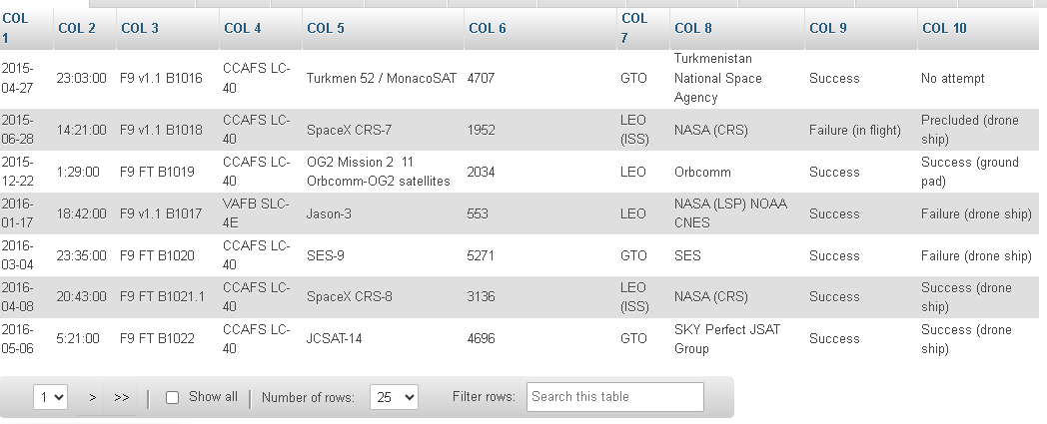
Task 1Display the names of the unique launch sites in the space mission

Slide 5
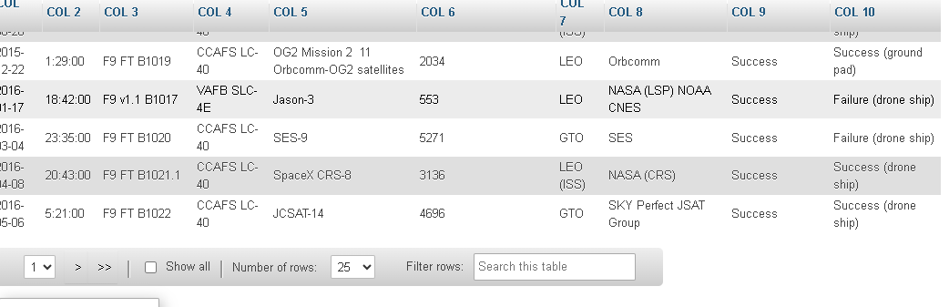
Task 2 Display 5 records where launch sites begin with the string 'CCA'

Slide 6
Task3 Display the total payload mass carried by boosters launched by NASA (CRS)
45596

Slide 7
Task 4:Display average payload mass carried by booster version F9 v1.1
2928.400000

Slide 8
Task 5 List the date when the first succesful landing outcome in ground pad was acheived.
2015-12-22

Slide 9
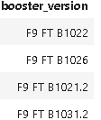
Task6 List the names of the boosters which have success in drone ship and have payload mass greater than 4000 but less than 6000

Slide 10
Task7 List the total number of successful and failure mission outcomes
100

Slide 11
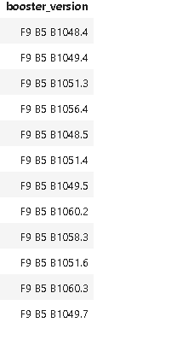
Task 8 List the names of the booster_versions which have carried the maximum payload mass. Use a subquery

Slide 12
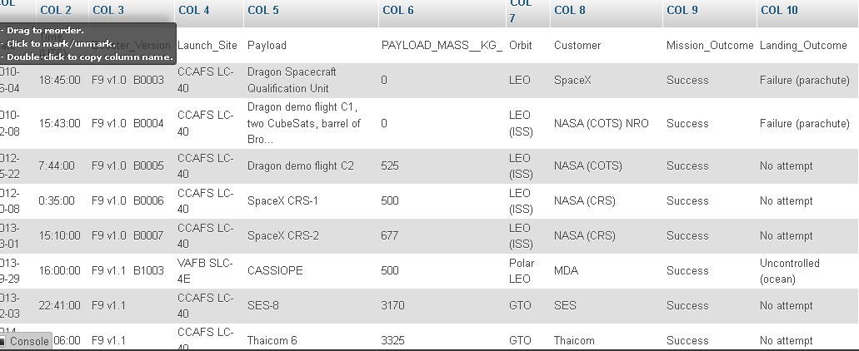
Task9 List the records which will display the month names, failure landing_outcomes in drone ship ,booster versions, launch_site for the months in year 2015

Slide 13
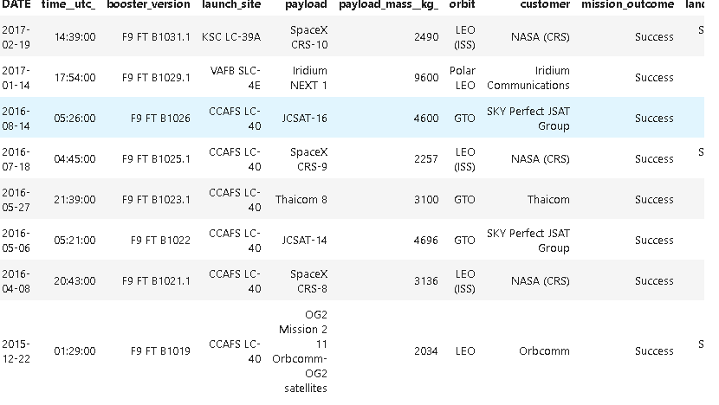
Task10 Rank the count of successful landing_outcomes between the date 2010-06-04 and 2017-03-20 in descending order.

